Slide 1
COURSERA CAPSTONE IBM APPLIED DAT SCIENCE
Preserving Lifestyle as an Expat on Other Continent
Moving from Toronto, Canada to Bucharest, Romania –
By: Florin Bogdan Dumitrescu

Slide 2
BUSINESS/SOCIAL PROBELM
The Problem
An expat can afford to rent any apartment in Bucharest compared with other western cities because of low prices
The Context
Many choose to rent in a very limited area
The Goal
This study aims to verify if there are alternatives for renting an apartment in oter neighborhoods

Slide 3
BENEFITS AND RESEARCH QUESTIONS
As benefits, an expat who is about to rent an apartment in Bucharest will be able to see:
the structure of venues for different Bucharest areas
particular to Canadian citizens, they will be able to know in advance where they can rent an apartment in order to conserve their life style from Toronto for example
The research questions are:
How are distributed city facilities in Toronto - Canada and Bucharest - Romania?
If I want to conserve my lifestyle from Toronto, where should I rent an apartment in Bucharest?
If I want to have quick access to some specific venues, where should I rent an apartment in Bucharest?
If I want to immigrate in Canada and rent an apartment in Toronto, from specific facilities point of view, what neighborhoods are more recommended?

Slide 4
DATA AND DATA SOURCES
1. For Toronto City
a. List of neighborhoods - https://en.wikipedia.org/wiki/List_of_postal_codes_of_Canada:_M
b. List of latitudes and longitudes coordinates for neighborhoods - http://cocl.us/Geospatial_data
c. Venue data explored using Foursquare API - https://developer.foursquare.com/
2. For Bucharest City
a. List of neighborhoods - https://ro.wikipedia.org/wiki/Lista_cartierelor_din_Bucuresti
b. Latitudes and longitudes coordinates for neighborhoods - Python geopy library will be used because no public service or free web data were found
c. Venue data - explored using Foursquare API - https://developer.foursquare.com/

Slide 5
METHODOLOGY
For Toronto city
1. Web scraping Wikipedia page for Toronto neighborhoods list - using BeautifulSoup library
2. Get latitude and longitude coordinates for Toronto using Geocoder
3. Use Foursquare API to get venue data
4. Group data by neighborhood and taking the mean of the frequency of occurrence of each venue category
5. Perform clustering on the data by using k-means clustering
6. Visualize the clusters in a map using Folium
For Bucharest city
1. Web scraping Wikipedia page for Toronto neighborhoods list - using BeautifulSoup library
2. Get latitude and longitude coordinates for Bucharest and Bucharest neighbourhoods using geocoder
3. Use Foursquare API to get venue data
4. Group data by neighborhood and taking the mean of the frequency of occurrence of each venue category
5. Perform clustering on the data by using k-means clustering
6. Visualize the clusters in a map using Folium

Slide 6
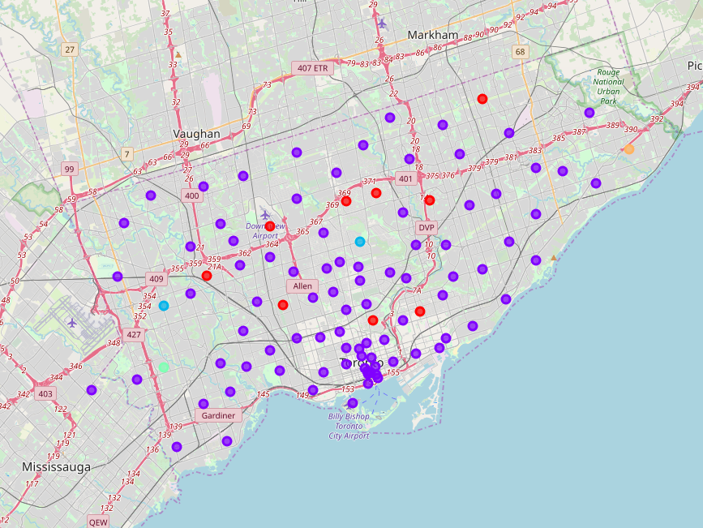
RESULTS - TORONTO CATEGORIZED NEIGHBOURHOODS -
Cluster 1 labels = Park, Stores
Cluster 2 labels = Restaurants, Shops
Cluster 3 labels = Park, Bus Line, Shops
Cluster 4 labels = Banks, Women Store, Drugstore
Cluster 5 labels = Bars, Women Stores, Diner

Slide 7
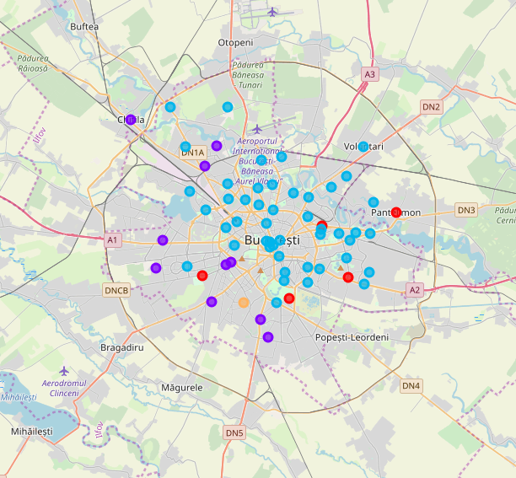
RESULTS - BUCHAREST CATEGORIZED NEIGHBOURHOODS -
Cluster 1 labels = Sports
Cluster 2 labels = Supermarkets, Pharmacies, Food
Cluster 3 labels = High-life
Cluster 4 labels = Transit zone
Cluster 5 labels = Auto, Food

Slide 8
RESULTS
Toronto Neighborhoods Clusters
Bucharest Neighborhoods Clusters

Slide 9
RESULTS
Toronto Clusters
Cluster 1 labels = Park, Stores
Cluster 2 labels = Restaurants, Shops
Cluster 3 labels = Park, Bus Line, Shops
Cluster 4 labels = Banks, Women Store, Drugstore
Cluster 5 labels = Bars, Women Stores, Diner
Bucharest Clusters
Cluster 1 labels = Sports
Cluster 2 labels = Supermarkets, Pharmacies, Food
Cluster 3 labels = High-life
Cluster 4 labels = Transit zone
Cluster 5 labels = Auto, Food

Slide 10
DISCUSSION
Toronto Findings
Toronto neighborhoods clustering shows that stores and shops are distributed along the entire city
Parks are grouped in 2 main clusters (1 and 3)
Specific women stores are in particular represented in 2 areas (4 and 5)
Restaurants and dinner places are distributed in 2 clusters – 2 and 5
Bucharest Findings
Bucharest seems to have a specific area dedicated to sports facilities (Cluster1)
General facilities that supports family life are groped in cluster 2
High life area is represented by cluster 3
There are 2 neighborhoods zones that should be avoided for an expat – clusters 4 and 5

Slide 11
RECOMMENDATIONS
As an expat, moving from Toronto-Canada or elsewhere into Bucharest, if you are interested in high-life you should target Bucharest neighborhoods from Cluster 3 (47 neighborhoods)
As an expat, moving from Toronto-Canada or elsewhere into Bucharest, you should avoid Bucharest neighborhoods from Clusters 4 and 5 (2 neighborhoods) because they are high transit zones ore set on perifhery
If you want to go into Toronto – Canada, you should know that the venues are represented in all neighborhoods zones but if you are interested in green areas neighborhoods clusters 1 and 3 might be recommended.
Same, for Toronto Canada, women’s facilities are represented better by clusters 4 and 5
If you are interested in restaurants and shops, cluster 2 might be recommended

Slide 12
RECOMMENDATIONS
Toronto Clusters
Cluster 1 labels = Park, Stores
Cluster 2 labels = Restaurants, Shops
Cluster 3 labels = Park, Bus Line, Shops
Cluster 4 labels = Banks, Women Store, Drugstore
Cluster 5 labels = Bars, Women Stores, Diner
Bucharest Clusters
Cluster 1 labels = Sports
Cluster 2 labels = Supermarkets, Pharmacies, Food
Cluster 3 labels = High-life
Cluster 4 labels = Transit zone
Cluster 5 labels = Auto, Food

Slide 13
RECOMMENDATIONS
Toronto Clusters
Cluster 1 labels = Park, Stores
Cluster 2 labels = Restaurants, Shops
Cluster 3 labels = Park, Bus Line, Shops
Cluster 4 labels = Banks, Women Store, Drugstore
Cluster 5 labels = Bars, Women Stores, Diner
Bucharest Clusters
Cluster 1 labels = Sports
Cluster 2 labels = Supermarkets, Pharmacies, Food
Cluster 3 labels = High-life
Cluster 4 labels = Transit zone
Cluster 5 labels = Auto, Food

Slide 14
CONCLUSIONS
Answering to specific research questions:
How are distributed city facilities in Toronto - Canada and Bucharest - Romania?
They are more equally distributed in Toronto-Canada neighborhoods then in Bucharest-Romania
If I want to conserve my lifestyle from Toronto, where should I rent an apartment in Bucharest?
If you are passionate about sports and fresh air, in cluster 1, if you want to conserve family facilities, in 2 and if you like to go out, in cluster 3
If I want to have quick access to some specific venues, where should I rent an apartment in Bucharest?
General venues like stores and other facilities are grouped in cluster 2 but specific (non-sports) facilities are gropued in cluster3. Despite the high concentration of expats in Pipera neighborhood, cluster 3 gropus 47 neighborhoods, so the options to rent and apartment are much, much more, even 30-40% of the deals are going in Pipera neighborhood due to real estate agents deals with developers and high business zone concentration.
If I want to immigrate in Canada and rent an apartment in Toronto, from specific facilities point of view, what neighborhoods are more recommended?
Venues are more diverse in cluster 2 but green zones are more represented in clusters 1 and 3; for women life-style 4 and 5

Slide 15
Thank You!

